Slide 1

Crime Analytics in the Cloud: AWS/ML Pipeline
Final Project Part B – DATS 6450
Group: cc-fall-2023 2
Kyle Hall – Spring 2025

Slide 2

AGENDA
Overview
Purpose of the Project:
Leverage AWS to build a scalable, end-to-end cloud-based pipeline for crime data analysis and predictive modeling of
arrest likelihood
Key Components:
Data (Chicago Crime Data)
Data ingestion (Amazon S3)
Data transformation (AWS Glue)
Model training and deployment (Amazon SageMaker)
Outcome visualization (Amazon QuickSight)
Presentation Roadmap:
Project Scope
Data Source
Features
Expected Outcomes
Project Architecture
Next Steps / Questions

Slide 3

Project Scope & Goals
Primary Objective: Build a cloud-based ML pipeline on AWS to analyze historical crime data and predict arrest likelihood with at least 70% accuracy
Secondary Objectives:
Identify crime hotspots via clustering and time-based trend analysis using scalable AWS compute resources.
Implement a scalable, automated workflow that can easily integrate new data over time.
Demonstrate how AWS services integrate to create an end-to-end ML solution from data storage to visualization.
Relevance:
Crime analytics can guide law enforcement resource allocation and inform policy decisions, leading to safer communities.
The cloud-based approach enables rapid scaling during peak analysis periods and reduces infrastructure maintenance costs compared to on-premises solutions.
Implementation could serve as a template for similar data science solutions across different public sectors.

Slide 4






Project Architecture
Data Storage: Amazon S3 bucket stores both raw crime data and processed datasets in separate folders
Data Processing: AWS Glue crawls and transforms the raw data, handling cleaning and feature engineering
Model Training: Amazon SageMaker uses the processed data to train and evaluate arrest prediction models
Deployment & Visualization: Best model deployed to SageMaker endpoint; QuickSight creates visual dashboards
Data Flow: Raw crime data → S3 → Glue ETL → Processed data in S3 → SageMaker Training → Model Deployment → QuickSight Visualization
Notes:
Data Flow Explanation: Crime Analytics Pipeline
Raw Data to S3: Crime data from public sources is uploaded into our S3 bucket's raw-data folder. This serves as the secure, scalable starting point for our pipeline.
S3 to Glue ETL: AWS Glue crawlers scan the raw data to understand its structure and create a data catalog. Then, Glue ETL jobs transform this data - handling missing values, creating new features like time-of-day indicators, and preparing it for machine learning.
Processed Data in S3: The cleaned, transformed data is stored back in our S3 bucket in the processed-data folder, ready for model training and analysis.
SageMaker Training: Amazon SageMaker pulls this processed data to train multiple classification models (Random Forest, XGBoost, LightGBM) that predict arrest likelihood. SageMaker handles the compute resources automatically, scaling as needed.
Model Deployment: The best-performing model (based on accuracy, precision, and recall) is deployed to a SageMaker endpoint, creating an API that can accept new crime incident details and return arrest predictions.
Inference/Visualization: Finally, we use the deployed model to make predictions on new data, and visualize both the predictions and crime patterns through QuickSight dashboards that law enforcement can use for resource allocation decisions.
This AWS-powered pipeline provides a scalable, automated solution that would be challenging to implement on traditional infrastructure, demonstrating the power of cloud computing for data science workflows.

Slide 5
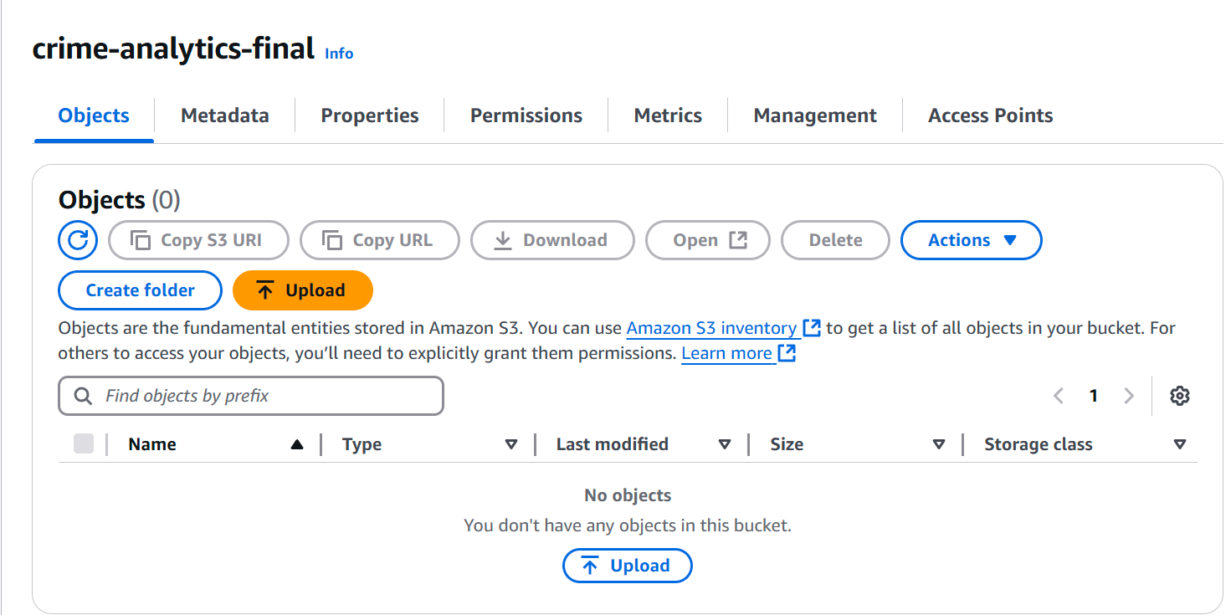
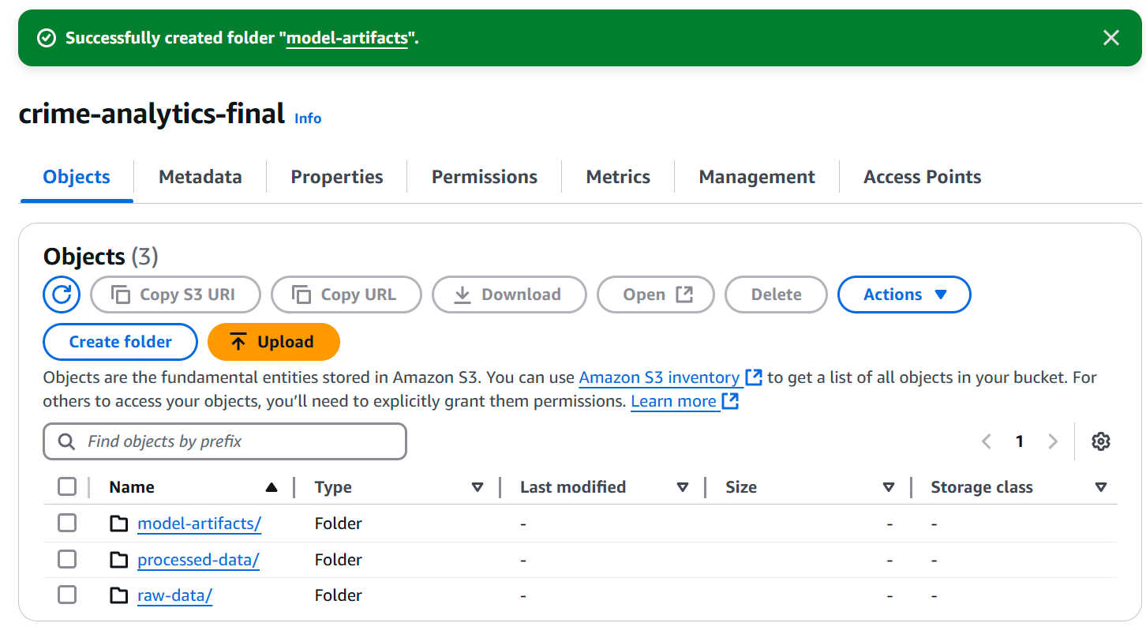
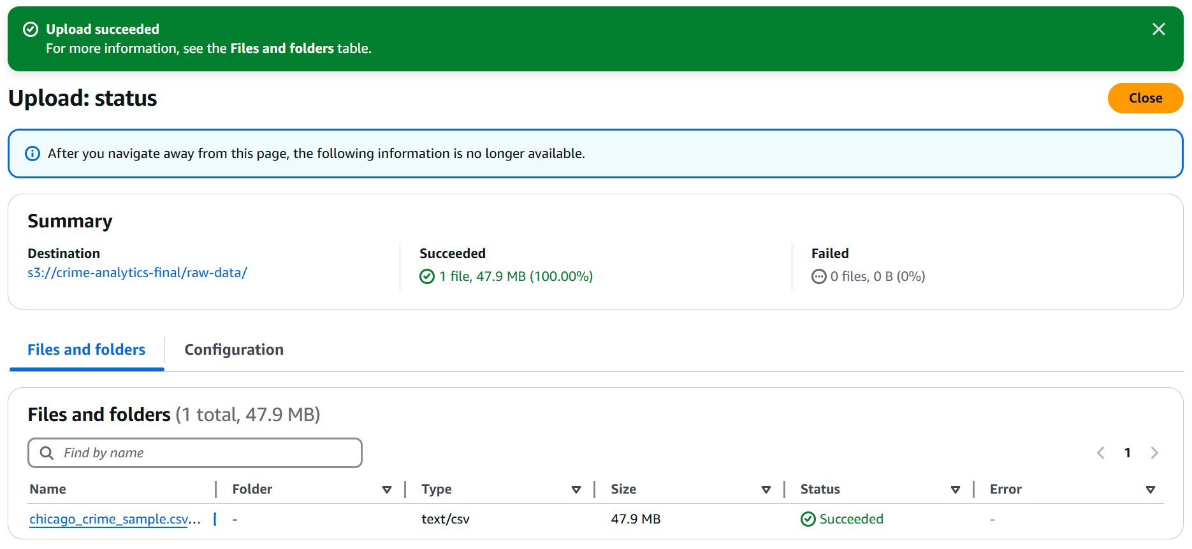
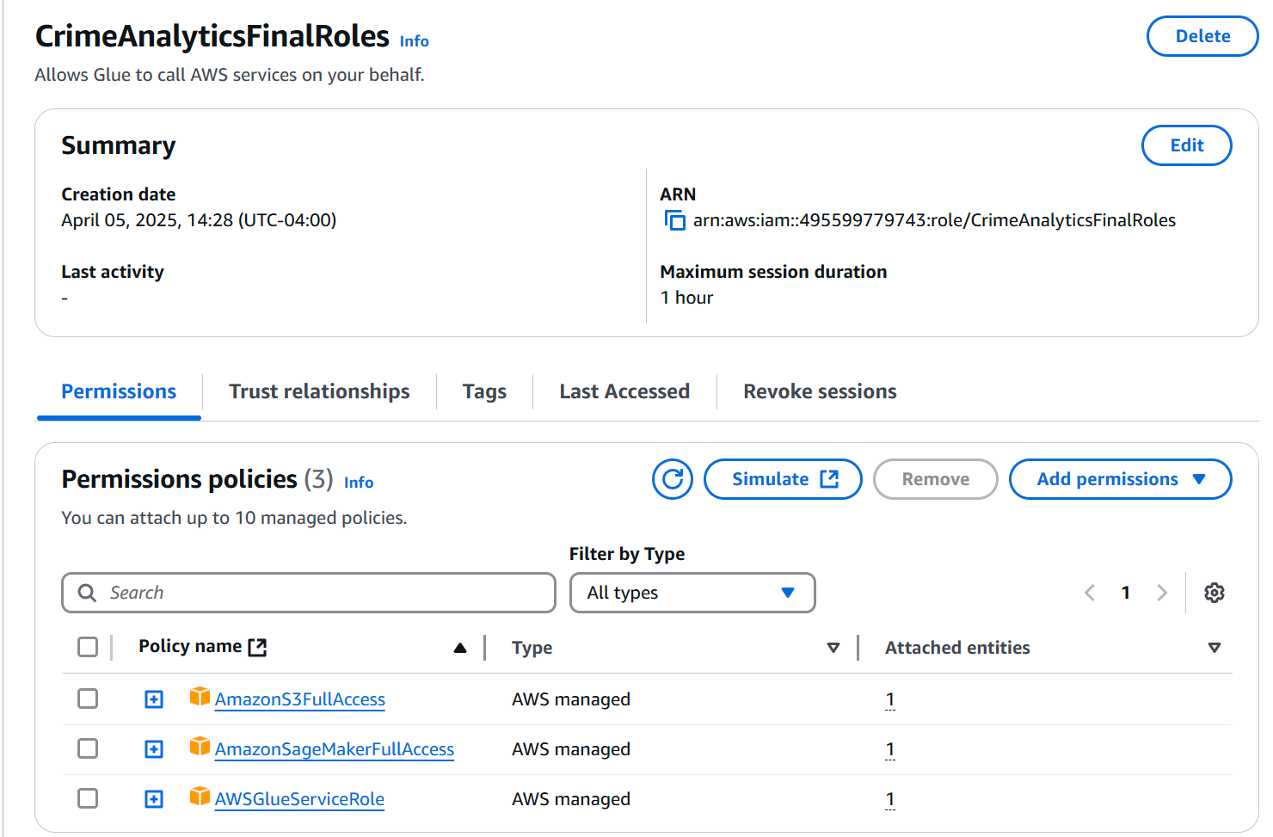
S3 Creation / IAM Roles

Slide 6
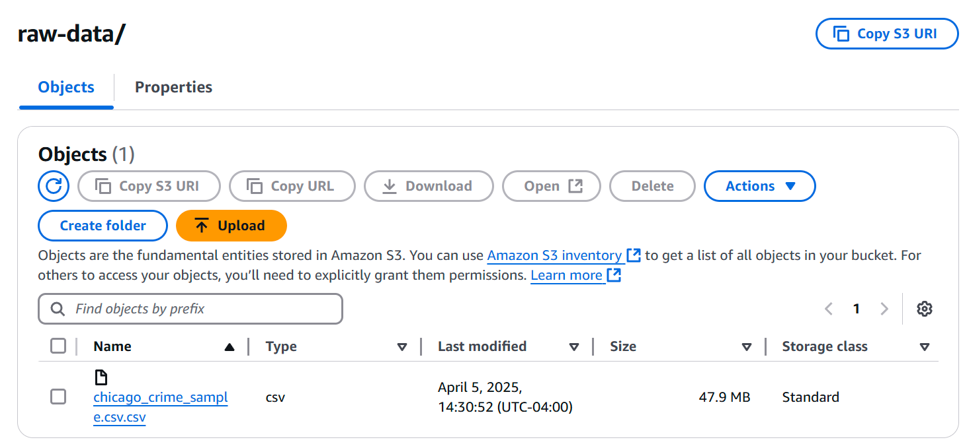
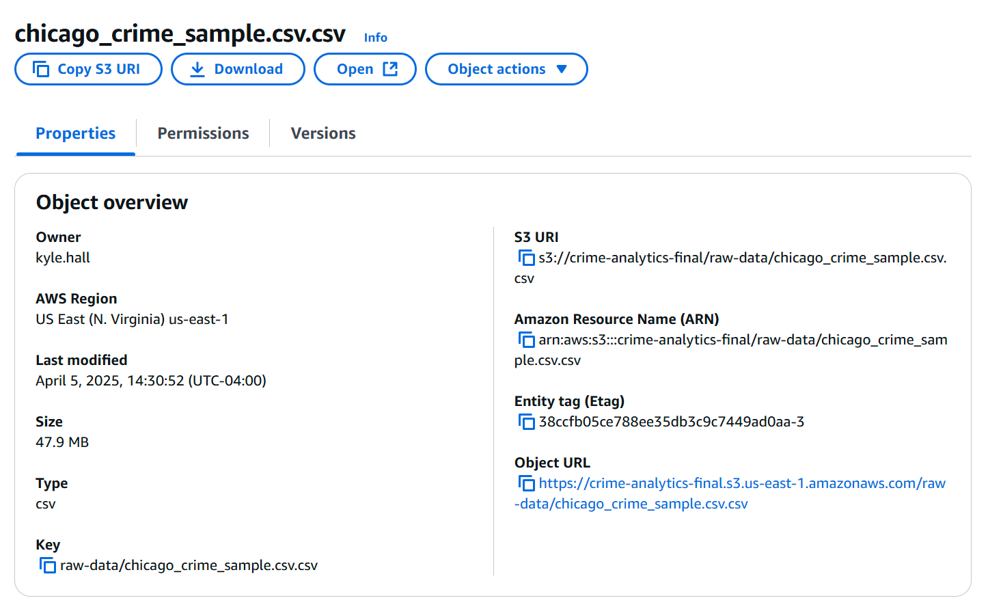
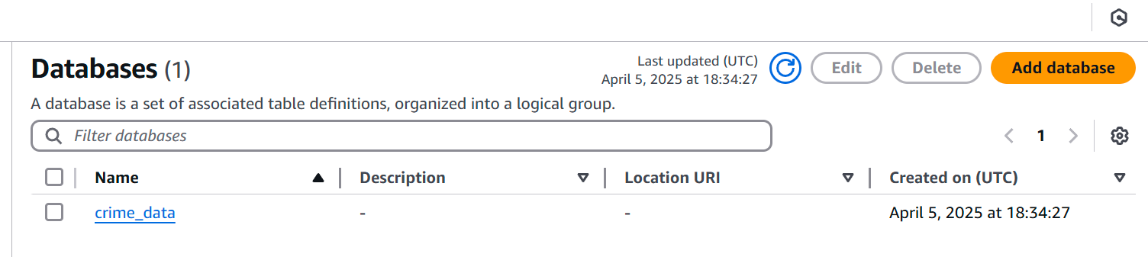
Data Upload / Glue DB Creation

Slide 7

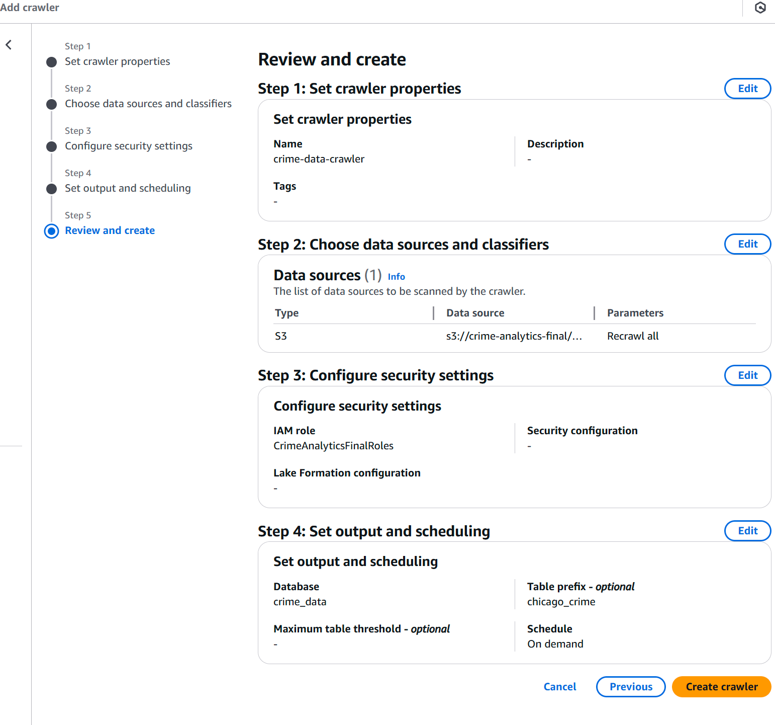
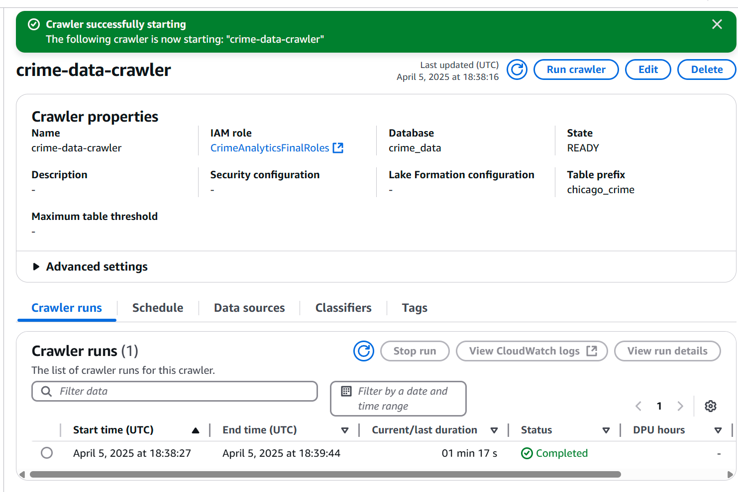
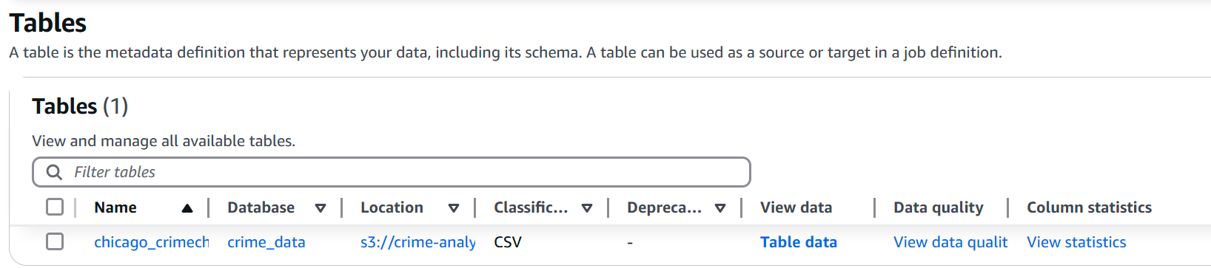
Crawler Creation / Run / Table
Notes:
Amazon S3 (Simple Storage Service):
Object storage service that offers industry-leading scalability and durability
Store and retrieve any amount of data from anywhere
Commonly used for data lakes, backup, archiving, and as storage for applications
Provides versioning, encryption, access control, and lifecycle management features
AWS Glue:
Fully managed extract, transform, and load (ETL) service
Makes it easy to prepare and load data for analytics
Includes Data Catalog which serves as a central metadata repository
Runs ETL jobs using Apache Spark environment without managing infrastructure
Can automatically discover and profile data from various sources
AWS Glue Data Catalog:
Central metadata repository for all your data assets
Integrates with Amazon Athena, EMR, and Redshift Spectrum
Stores table definitions, schema information, and partitioning details
Enables data discovery and governance
Amazon SageMaker:
Fully managed machine learning service
Helps data scientists and developers prepare, build, train, and deploy ML models quickly
Provides pre-built notebooks, optimized algorithms, and managed training infrastructure
Supports automatic model tuning, easy deployment, and scaling
Allows for bringing your own algorithms and frameworks
Amazon QuickSight:
Business intelligence (BI) service that makes it easy to create and publish interactive dashboards
Connects to various data sources including AWS data services
Provides ML insights, interactive visualizations, and embedded analytics capabilities
Offers pay-per-session pricing model
Scales automatically to thousands of users without infrastructure management

Slide 8

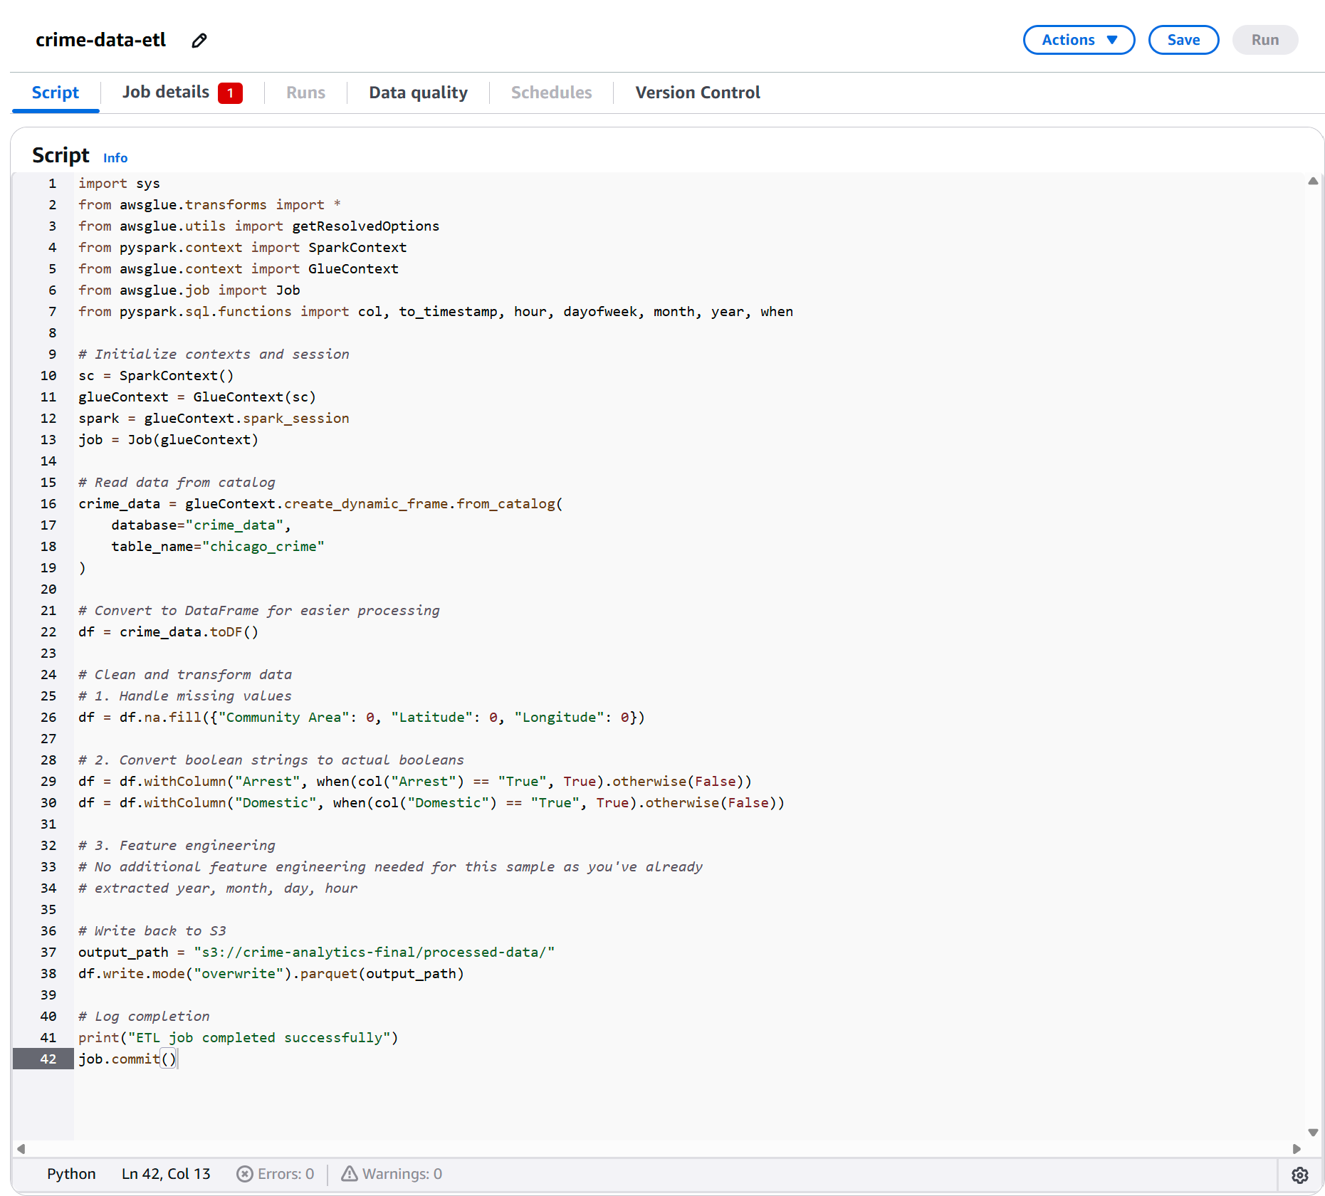
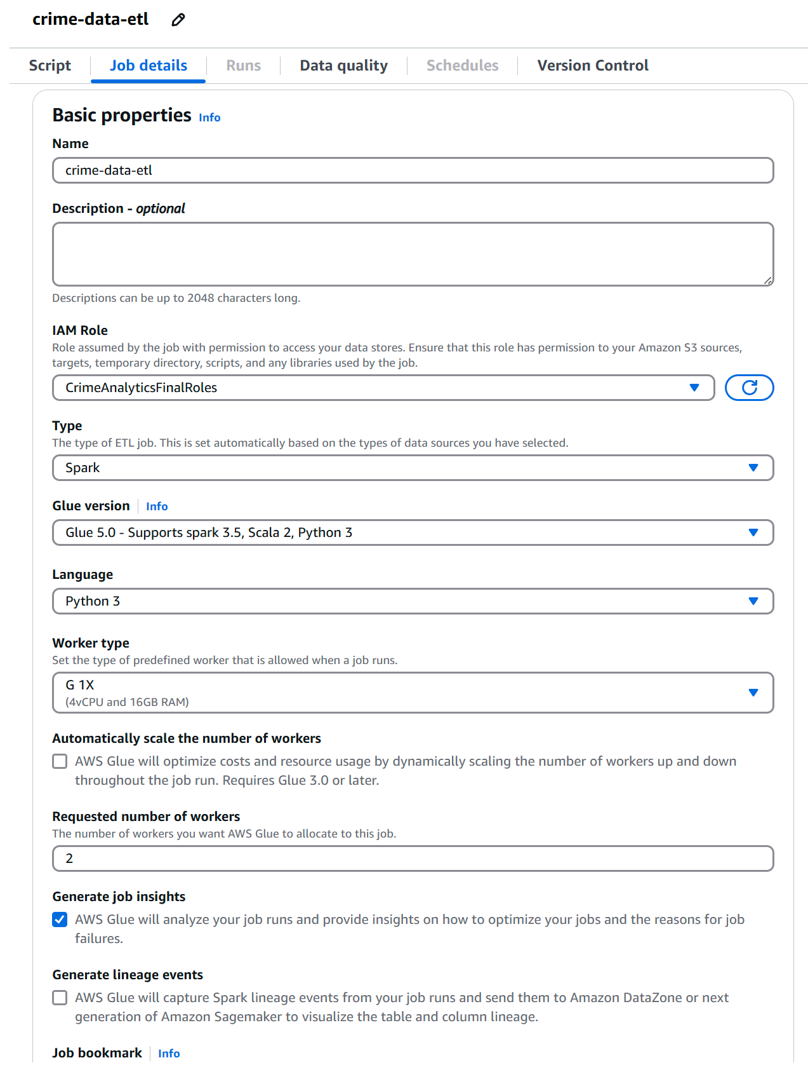
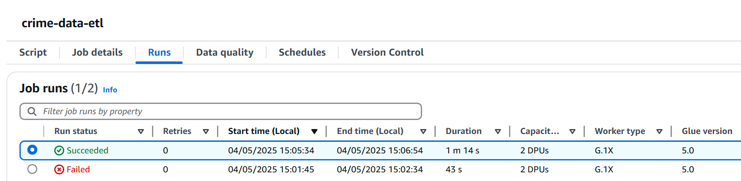
ETL Creation / Run

Slide 9
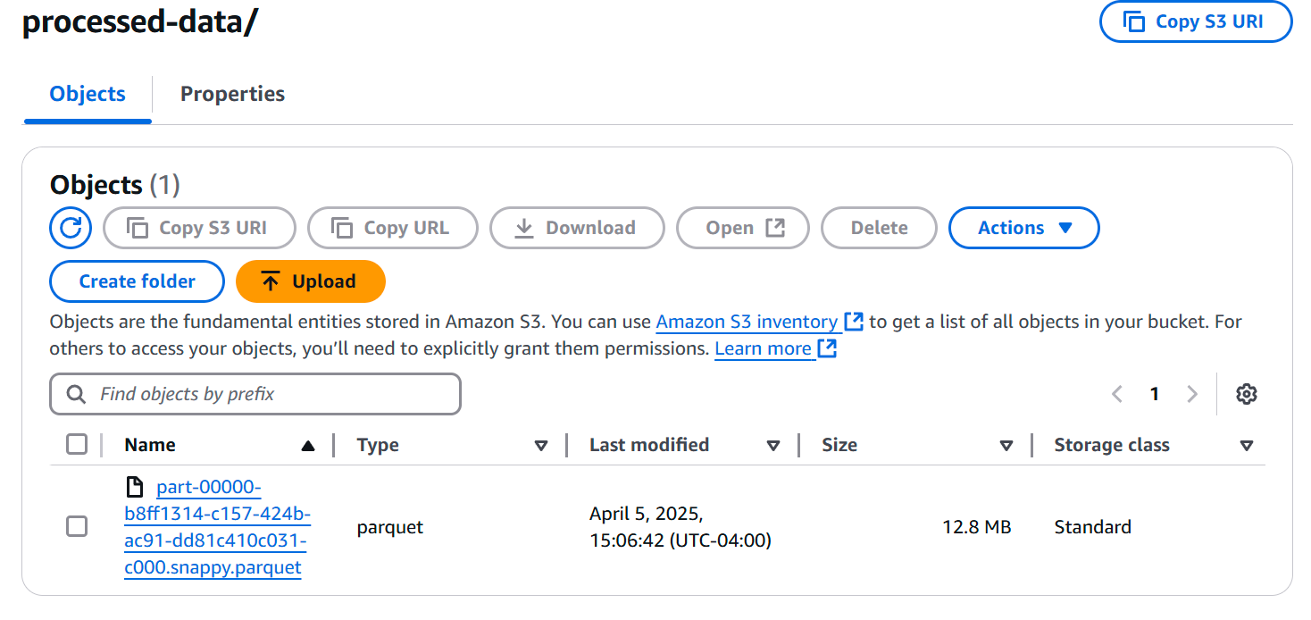
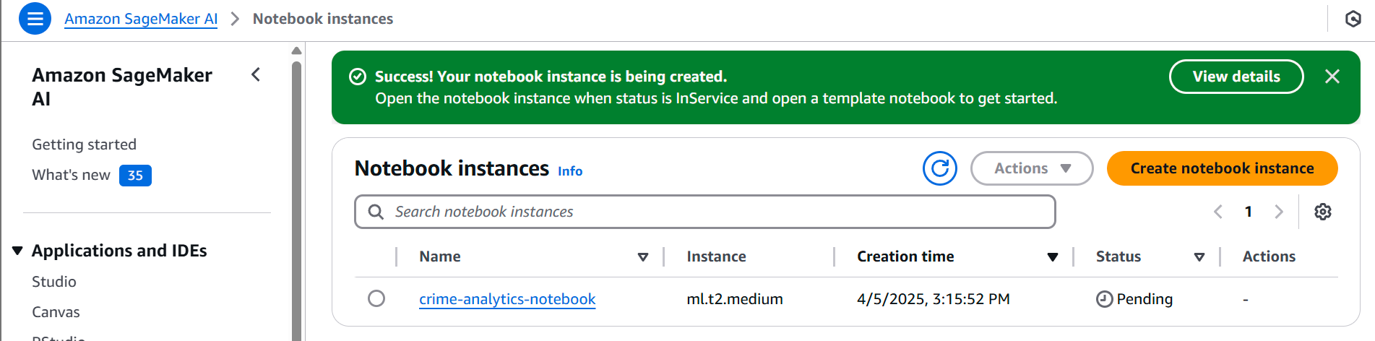
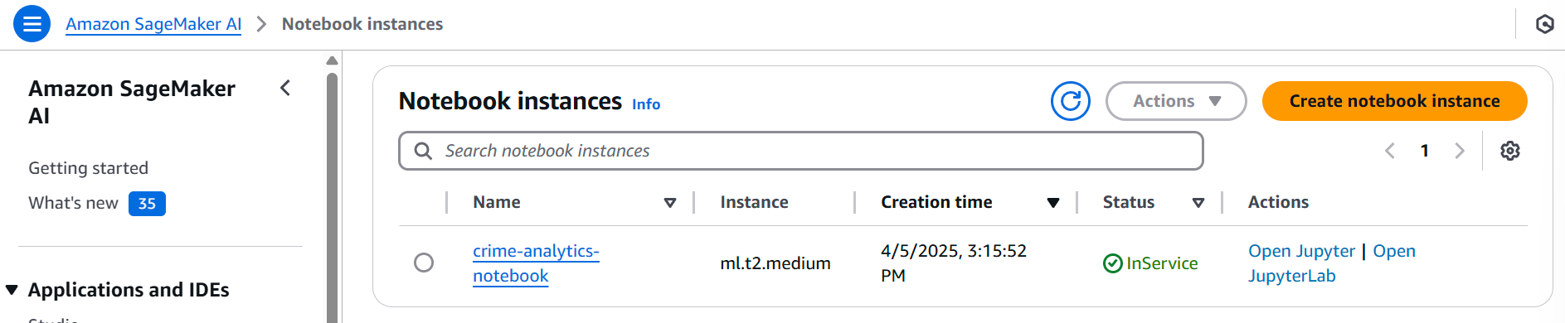
Processed Data / Sagemaker Notebook
Notes:
Original Dataset is over 2 gigs in size

Slide 10
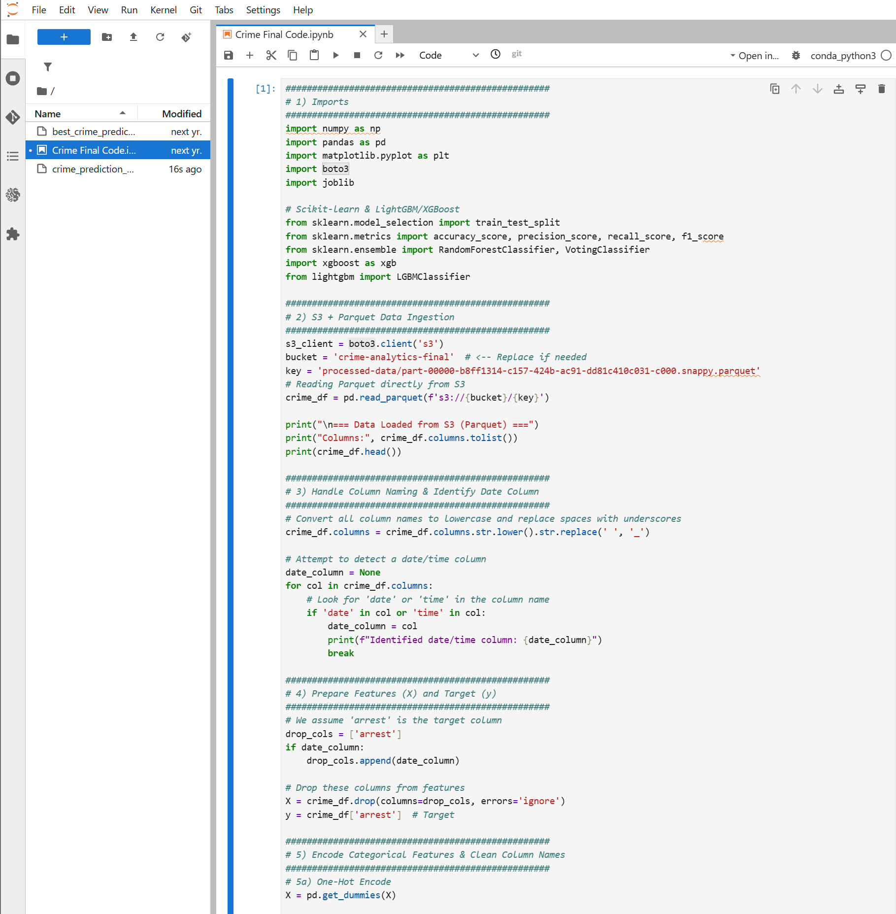
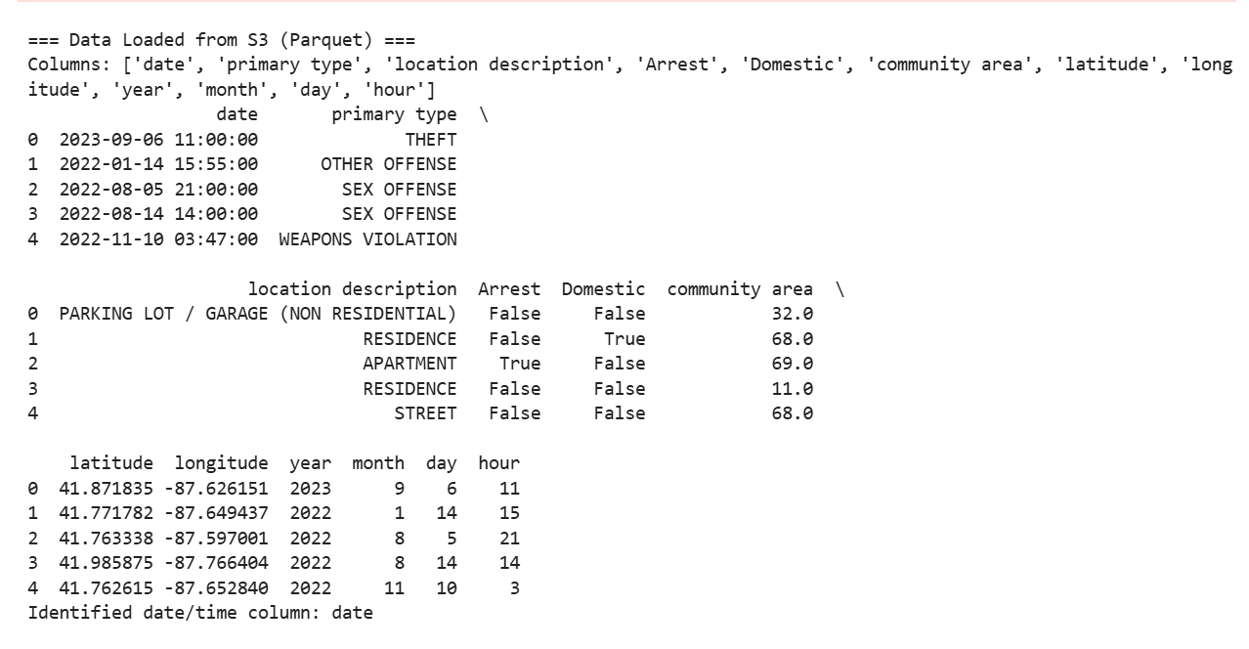
Sagemaker Code Implementation
Notes:
Original Dataset is over 2 gigs in size

Slide 11
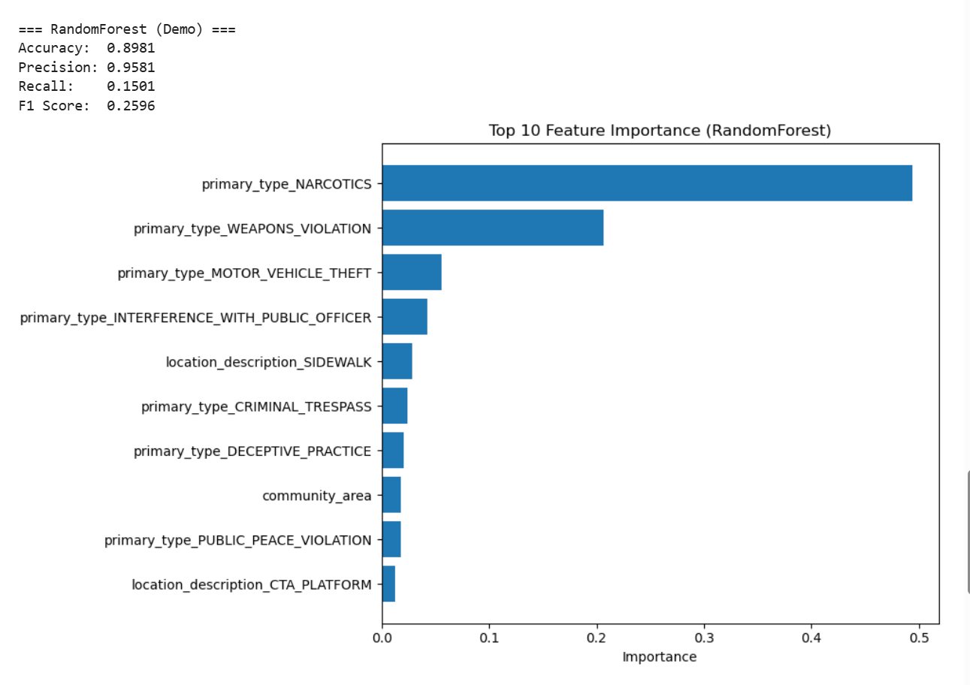
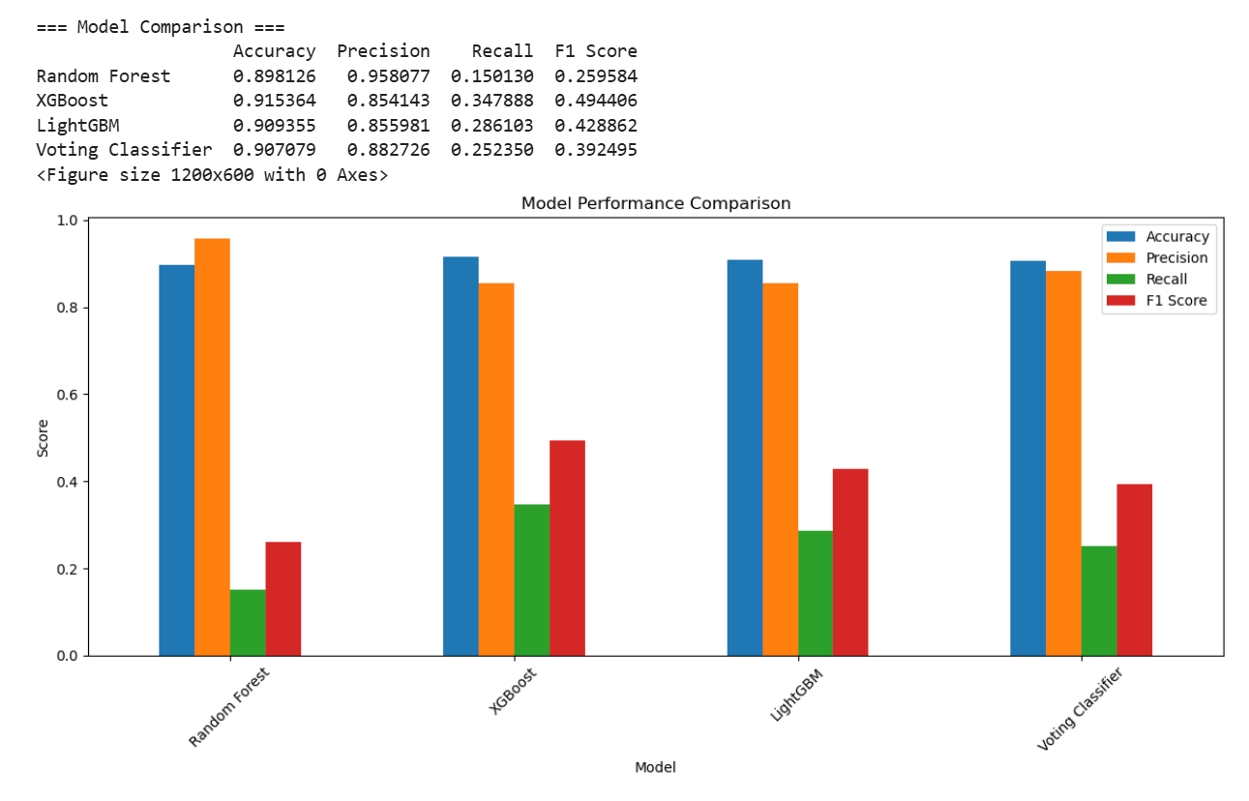
Model Results and Comparison
Notes:
Original Dataset is over 2 gigs in size

Slide 12
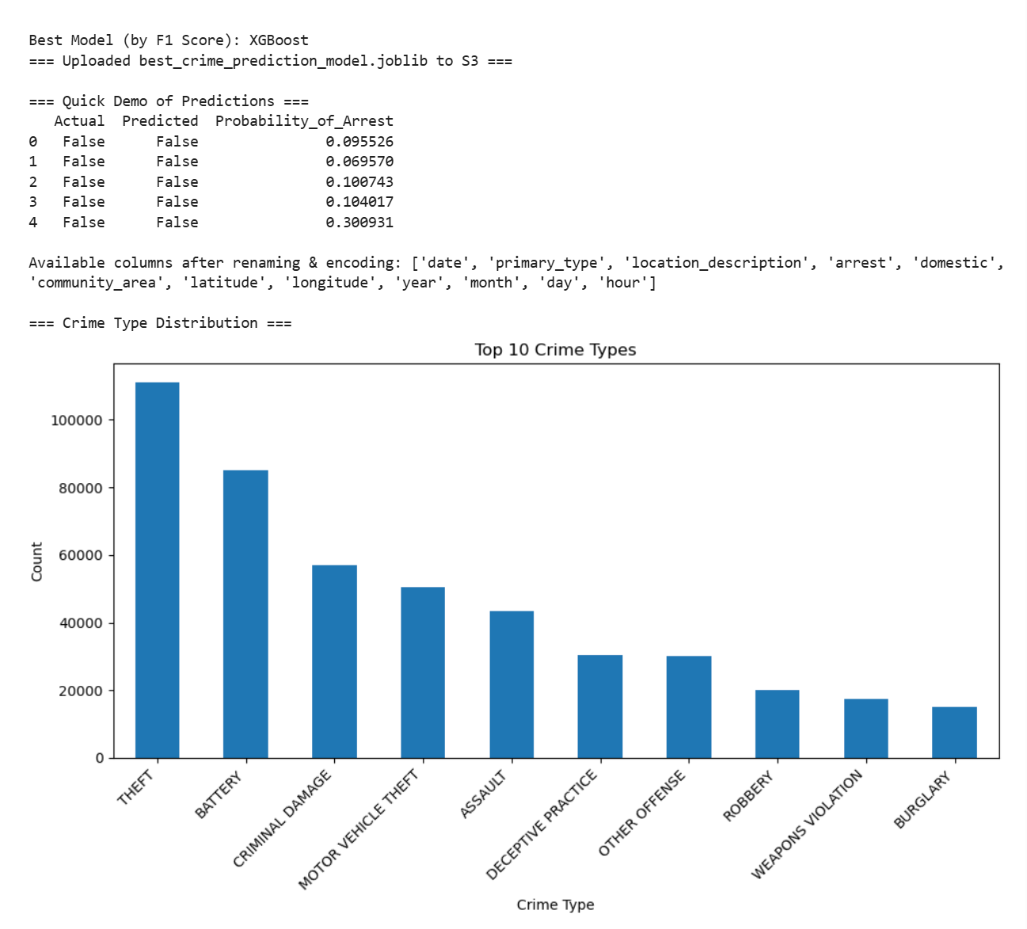
Best Model (Xgboost)

Slide 13
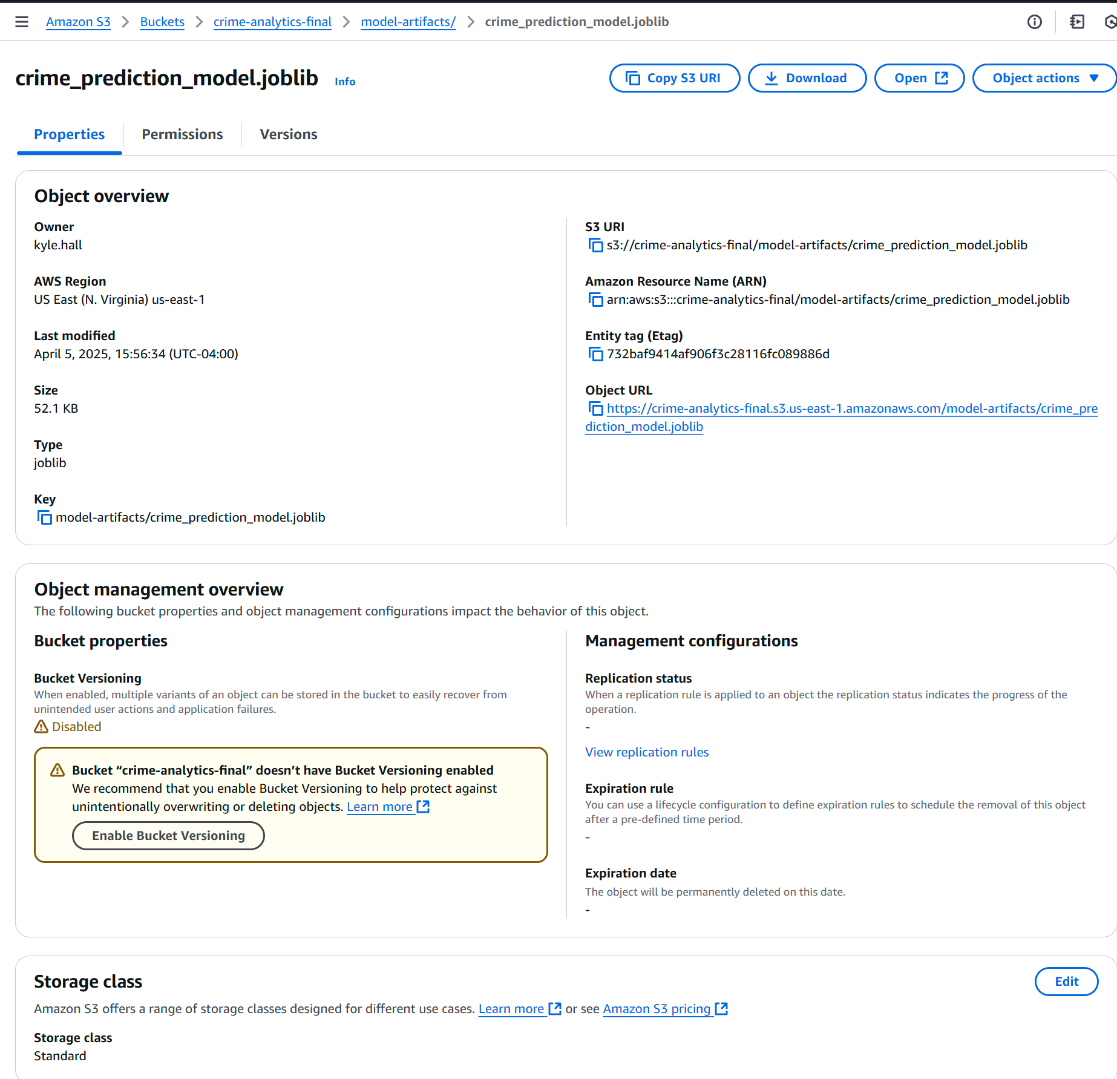
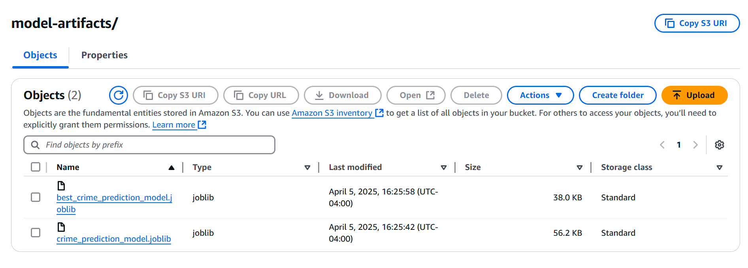
Best model Saved to s3
Notes:
Original Dataset is over 2 gigs in size

Slide 14
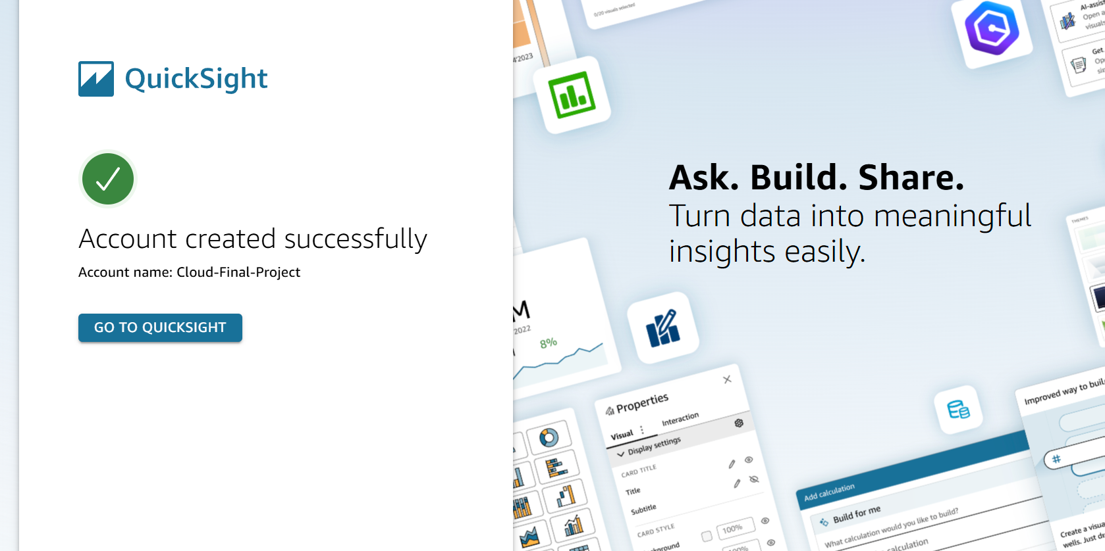
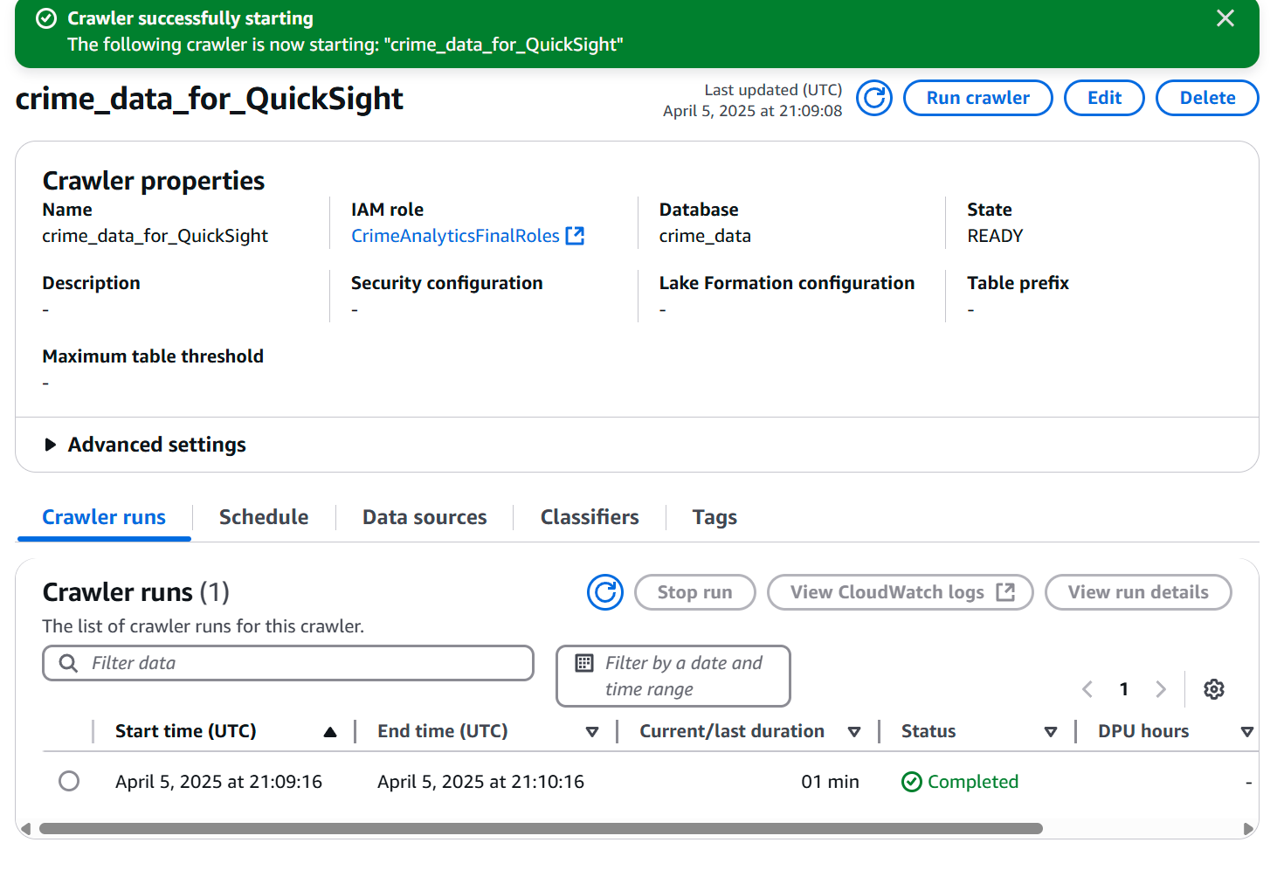
Quicksight creation + Crawler
Notes:
Original Dataset is over 2 gigs in size

Slide 15
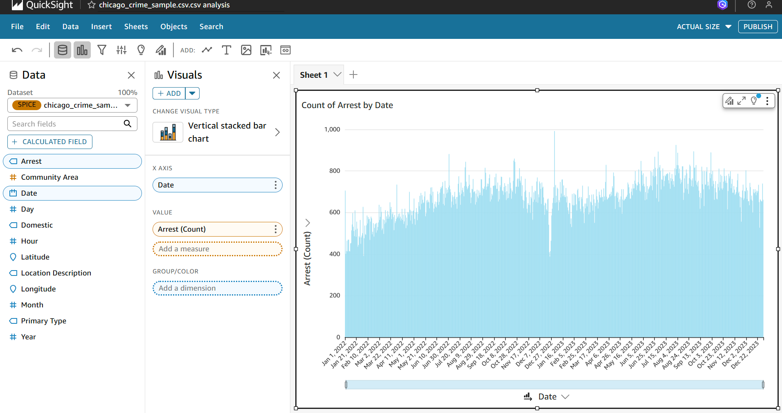
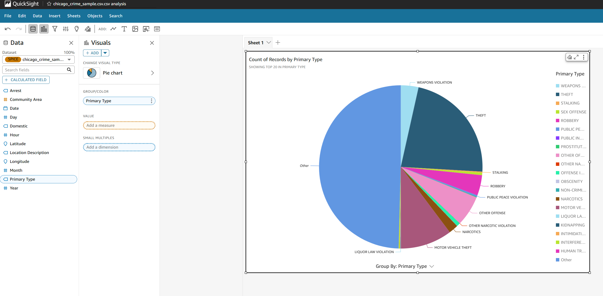
Quicksight Visualizations
Notes:
Original Dataset is over 2 gigs in size

Slide 16
Future Extensions / Lessons Learned
Future Extensions
Deploy model to a scalable SageMaker endpoint with auto-scaling for handling variable prediction loads
Develop more sophisticated models incorporating external data sources
Databricks integration
Cost Optimization:
Selected t2.medium instance for SageMaker development to minimize compute costs while maintaining functionality
Avoided continuous deployment of SageMaker endpoints during development, using batch predictions instead
Configured QuickSight for trial rather than annual subscription
Lessons Learned
Overcame initial Glue crawler configuration challenges by directly reading from S3
Needed to create a second crawler to format the data for Quicksight
Learned to efficiently integrate multiple AWS services while maintaining proper IAM policies
Notes:
Original Dataset is over 2 gigs in size

Slide 17

Questions?
Final Project Part B – DATS 6450
Group: cc-fall-2023 2
Kyle Hall – Spring 2025
Kyle.hall@gwu.edu
https://github.com/Kyleinexile/Cloud-Final

